Slide 1
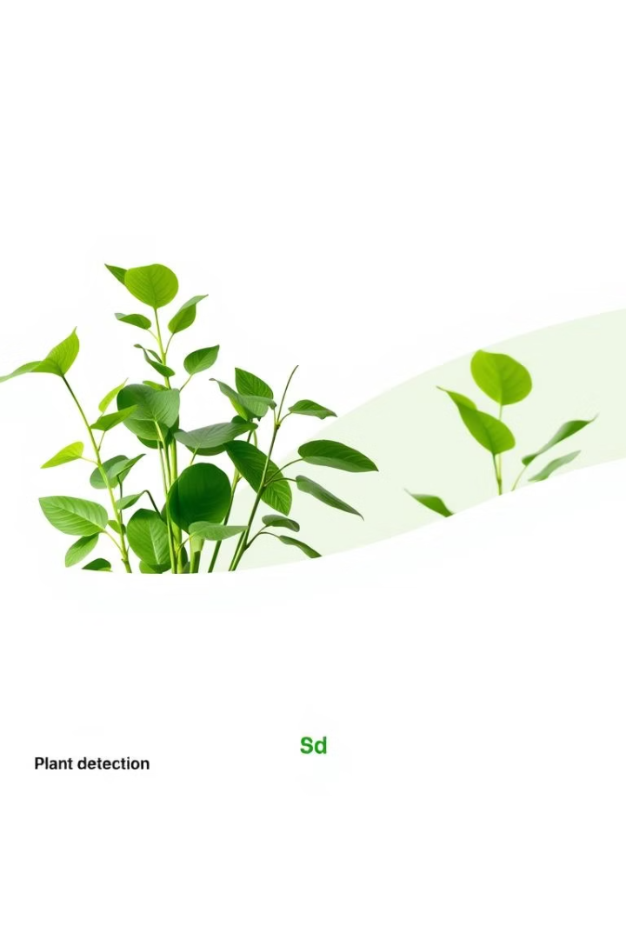


Plant Detection Using Streamlit
SAKSHI GARG (2401010178)
VANDANA SHARMA (2401010285)
POOJA AGGARWAL (2401010240)
JYOTI SURYAVANSHI (2401010291)
PROJECT MENTOR : - DR. PANKAJ AGGARWAL

Slide 2
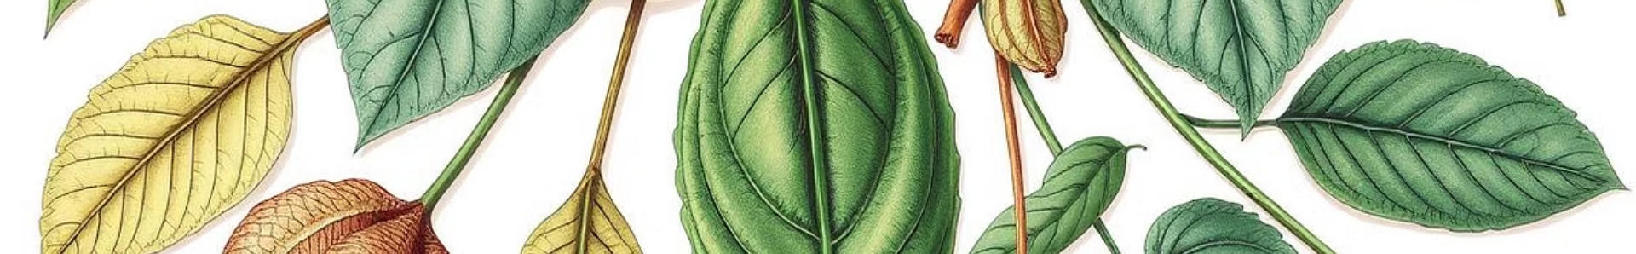





Why Do We Need a Plant Recognition App?
Research & Education
Agriculture Support
Environmental Conservation
Accessibility & AI
Enables quick plant species identification
Helps farmers identify crops and weeds
Catalogs rare and endangered plants
Empowers gardeners and nature lovers
Supports biodiversity and ecological studies
Detects diseases early for timely treatment
Supports reforestation and habitat restoration
Delivers instant, accurate AI-based IDs
Facilitates learning for students and researchers
Boosts yield with informed decisions
Eliminates manual errors, speeds process

Slide 3
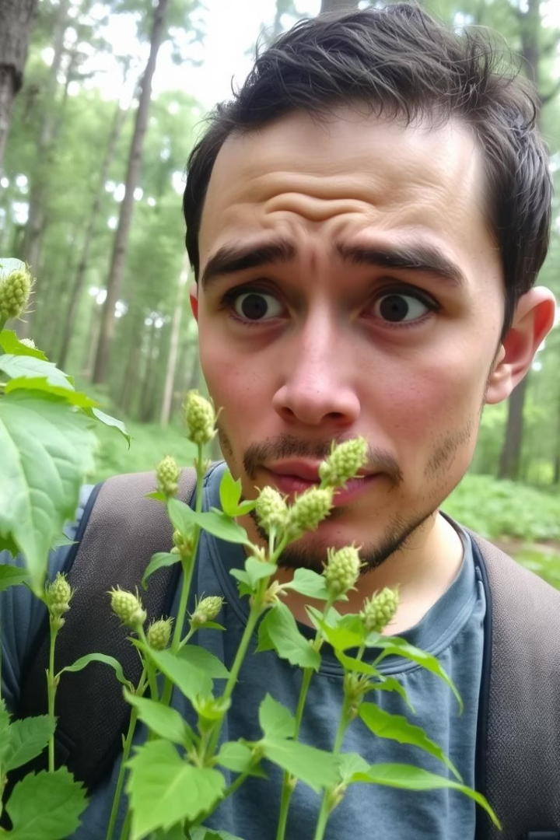
Problem Statement
Manual Identification Challenges
Importance
Critical for agriculture, biodiversity, research
Time-consuming and prone to errors
Our Solution
Real-time plant detection web app

Slide 4
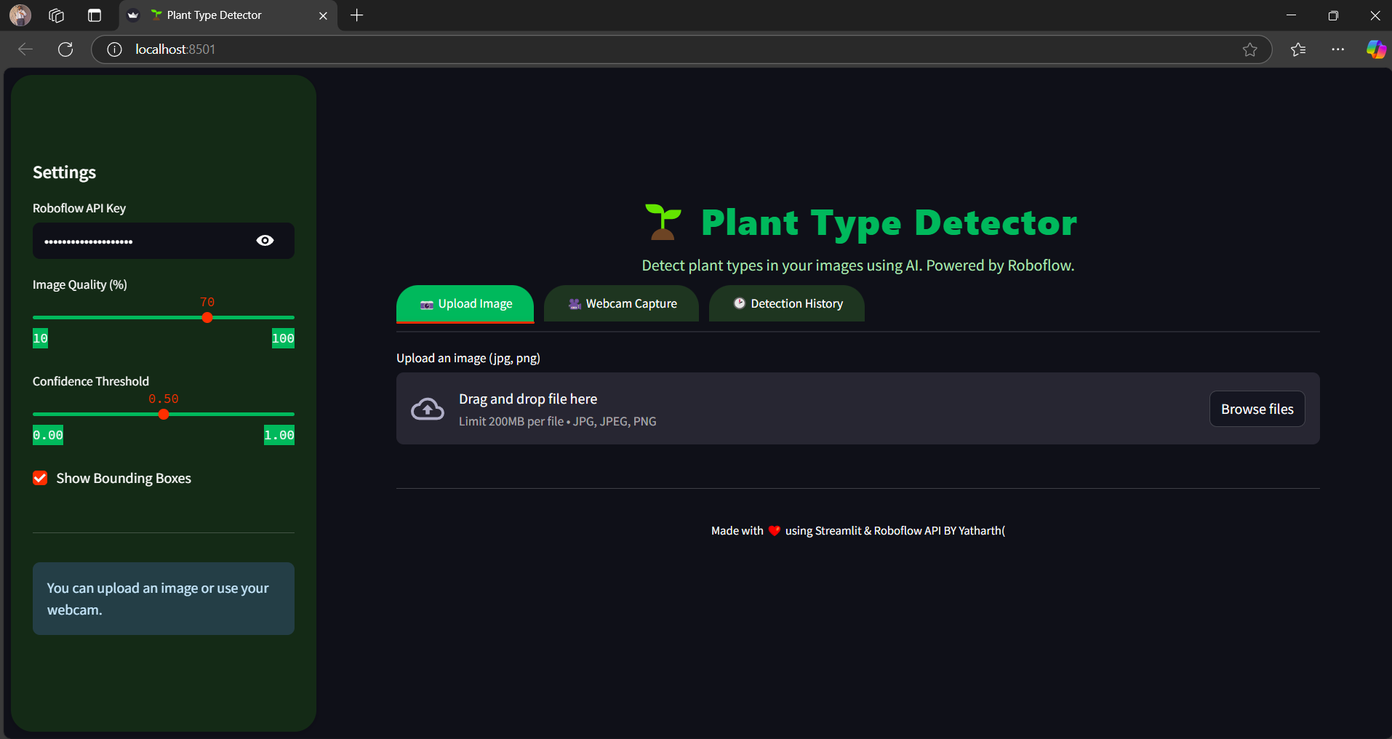
Our Solution
Organized Input
Image uploads or webcam stream
Real-time Inference
Bounding boxes with plant labels
Simple UI Controls
Adjust detection threshold easily
Clear Results
Instant plant identification display

Slide 5
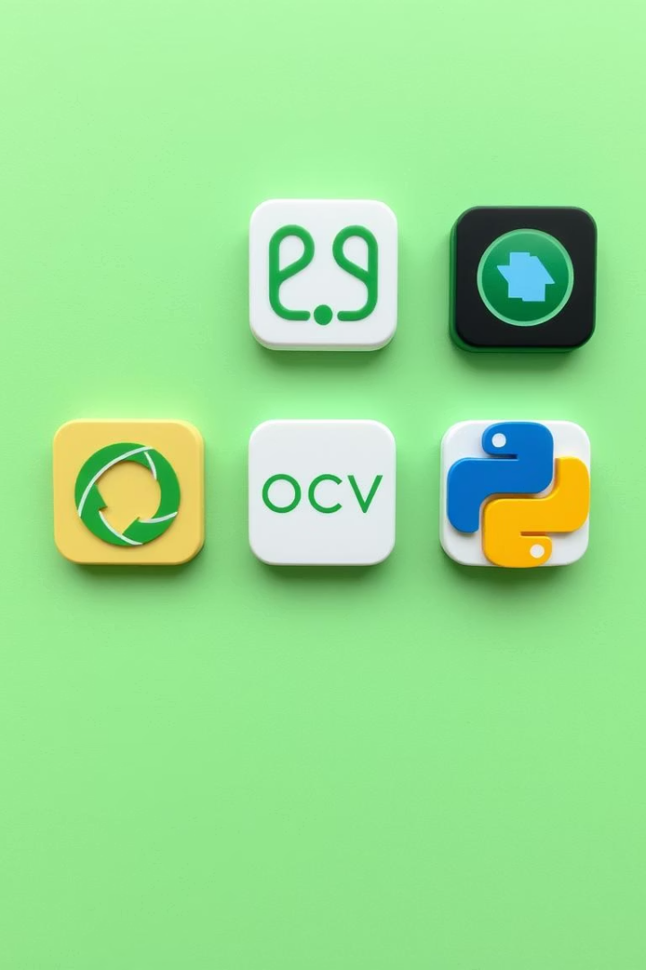
Methodology & Approach
Architecture
Streamlit frontend
Backend inference API
Tech Stack
Python, PIL, OpenCV, numpy
inference_sdk integration
UI/UX
Minimal, responsive design
Real-time image feedback

Slide 6
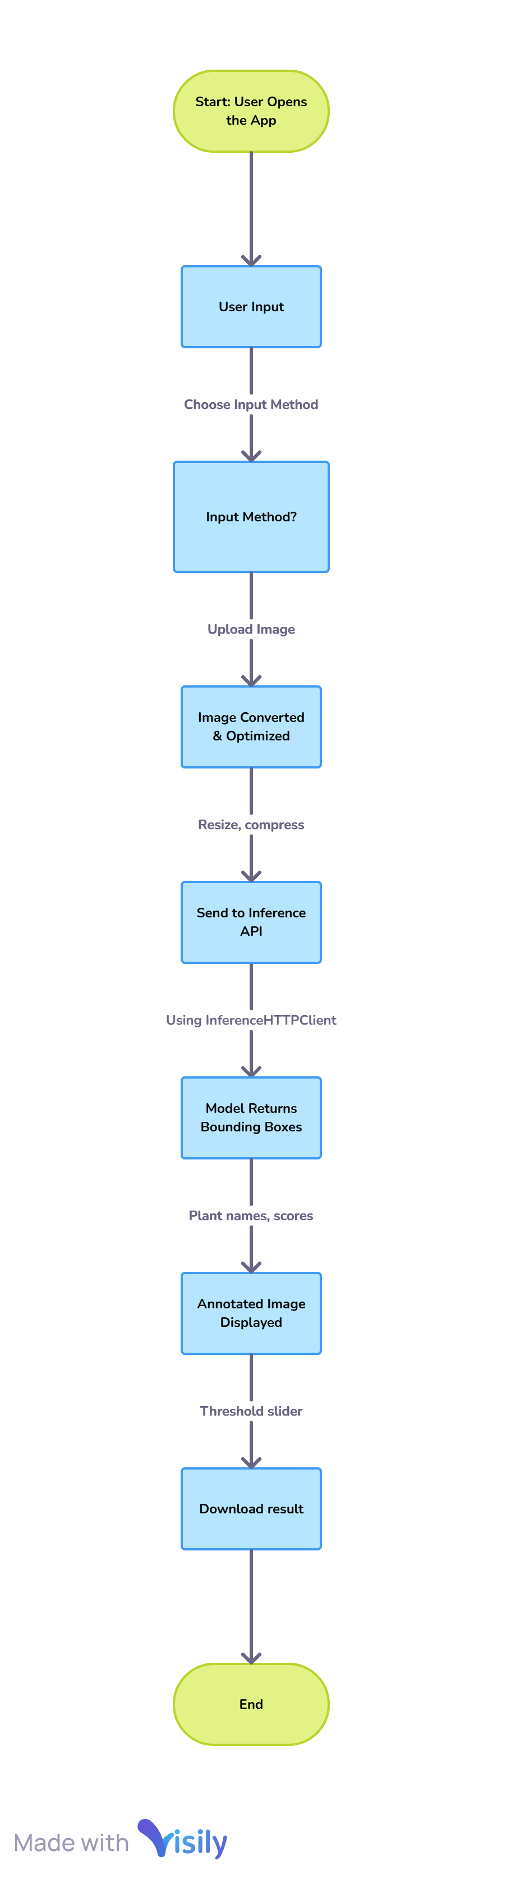
AI/ML Integration
Inference Client
Key Libraries
Detects plant species accurately
Streamlit UI
OpenCV & Pillow
NumPy for data processing
Features
Dynamic threshold control
Real-time bounding box overlays

Slide 7
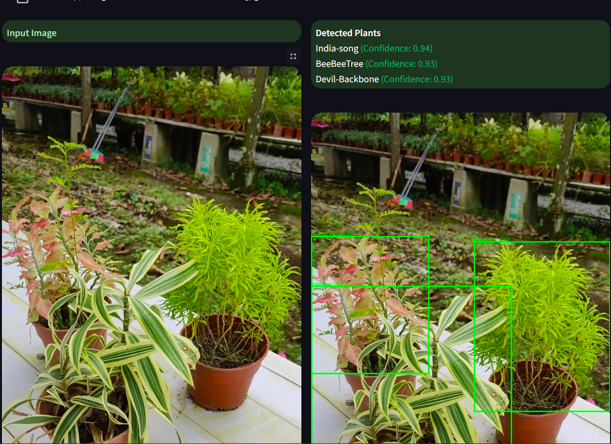
Demonstration
Upload or Capture
Choose image or use webcam
Real-Time Inference
Model processes image instantly
Visual Feedback
Bounding boxes and labels displayed

Slide 8
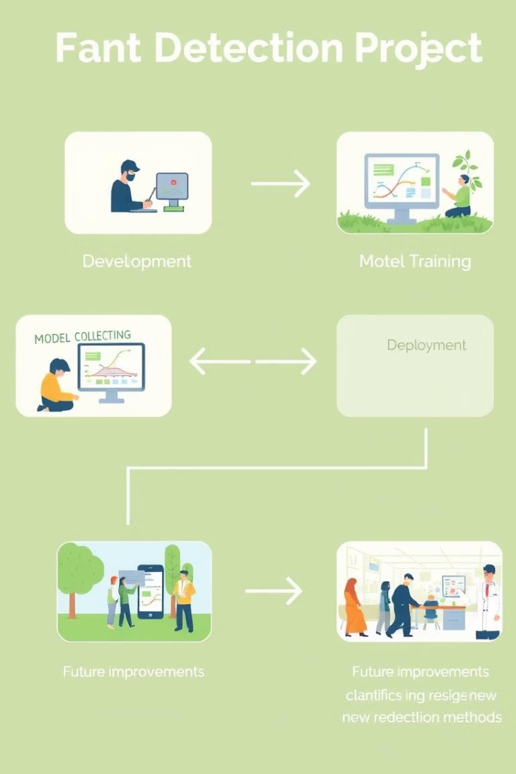





Key Takeaways & Next Steps
Innovation
Real-time plant species detection
User Focus
Simple, responsive web app design
Expandability
Future offline and feature enhancements
Collaboration
Team expertise drove success

Slide 9
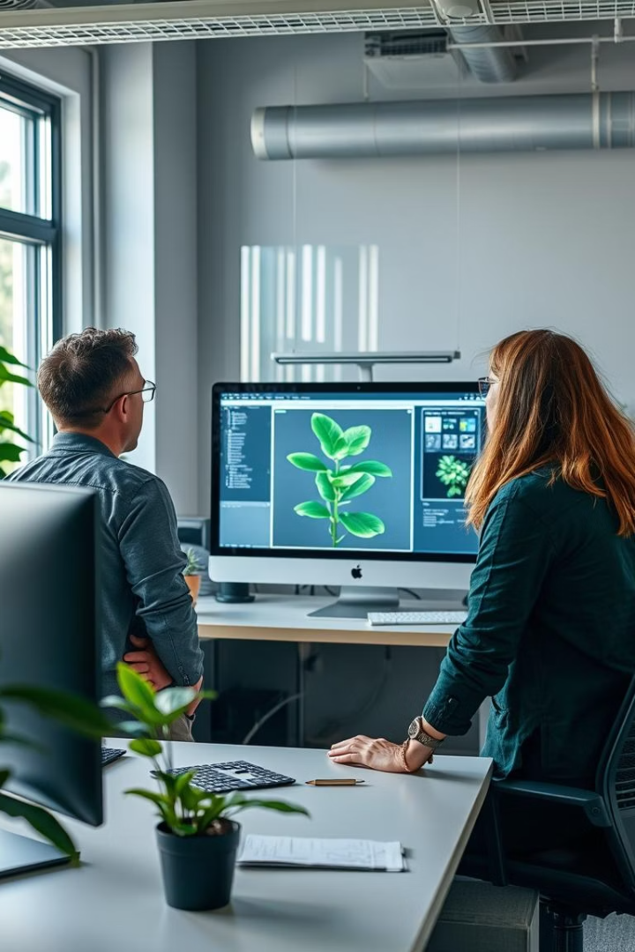
Conclusion
Learning Highlights
Computer vision hands-on experience
Streamlit for UI development
Future Plans
Offline model support
Plant care tips integration
Enhanced UI design

